Slide 1
Image Classification using HOG/LBP feature extraction in Machine Learning MATLAB
Md Asaduzzaman Jabin
Graduate Student
School of Electrical and Computer Engineering
University of Georgia, GA-30602
Email: mj71006@uga.edu

Slide 2
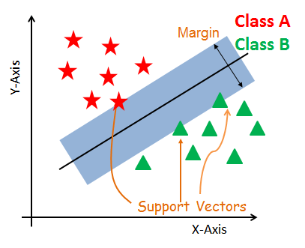
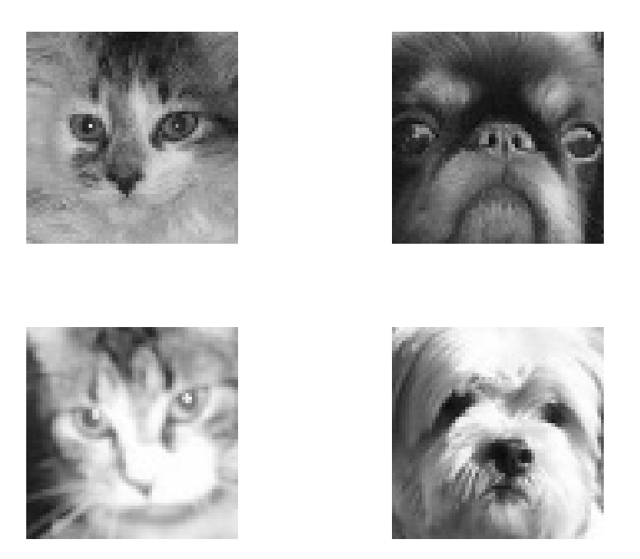
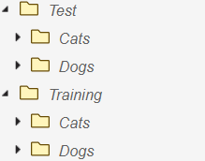
Introduction
Research Question
Classify Cats and Dog images using the classification app in MATLAB
Cats and Dog Analysis
Comparison Study:
a) Feature extraction using HOG/ LBP features
1. Access and Load data
2. Preprocess
Data Set
3. Derive Features
Kaggle data set: Cats and Dogs faces 1000 images/class (Ref.1)
Initial Size- Training 100 image/ class, Test 10 image/class
Class/ Data Labeling: 2, Cats and Dogs
Data Characteristics: Grayscale, Front facing image, 64*64 pixels
with slightly blurred.
4. Model Training
5. Model Tuning
6. Result
Workflow
Ref. 1 https://github.com/andechen/EK381-Prob-Stats-Data-Science/tree/main/catsfolder

Slide 3
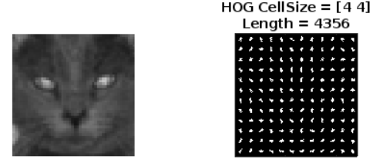

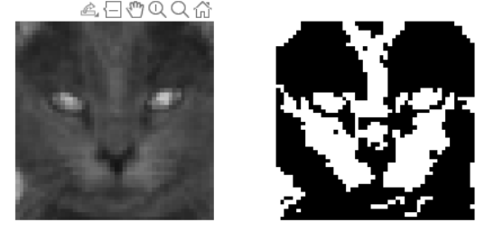
Workflow
1. Access and Load data
HOG
2. Preprocess
a) Resize the Image into 48*48
LBP
3. Derive Features:
b) De-noising and Normalize the Image
HOG/ LBP feature Extraction: 4*4 and 32*32 pixels
Number of Hog features trained: 4356
Number of LBP features trained: 2048

Slide 4

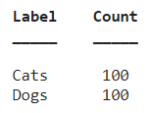
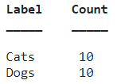

Workflow
3. Train a model
a) Train and Test manually
Current Accuracy: 90%
Notes:
how much you want to avoid misclassifying each training example

Slide 5




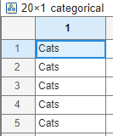
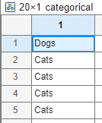





Misclassified
Test set
Predicted
Blurred image
misclassified
image
Perfectly classified

Slide 6
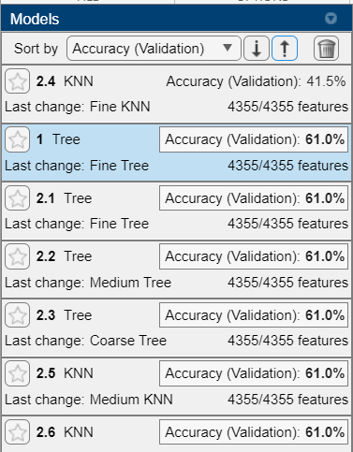
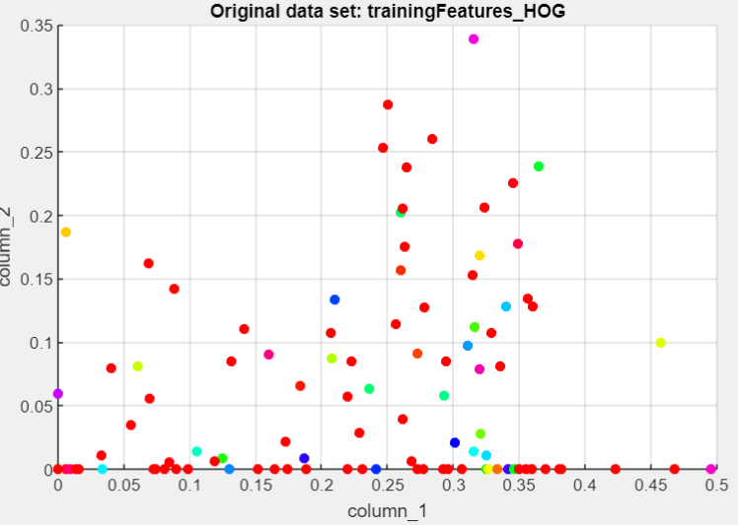
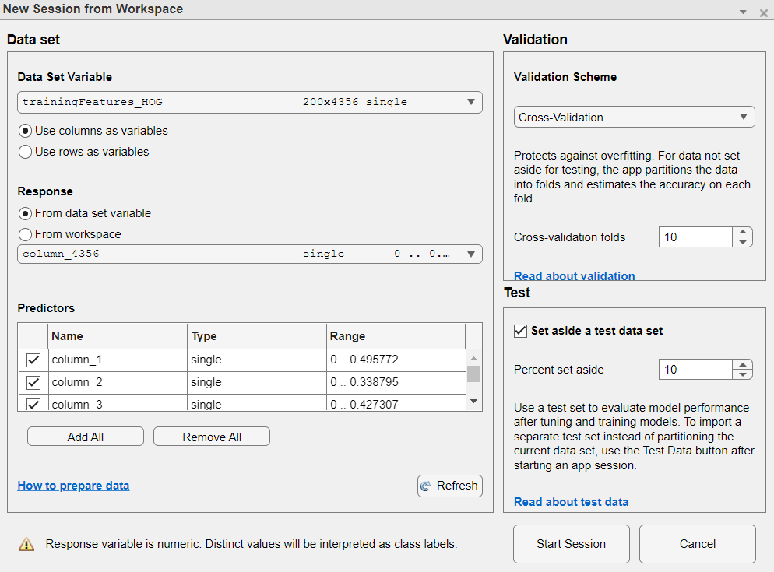
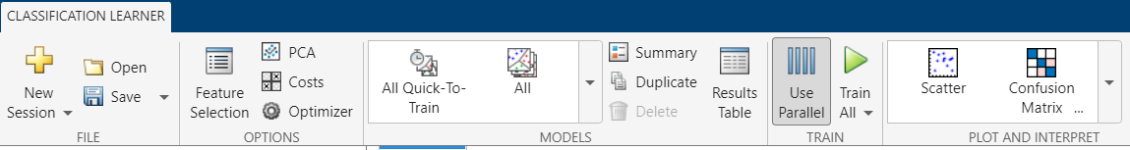
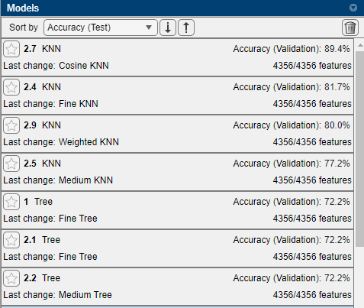
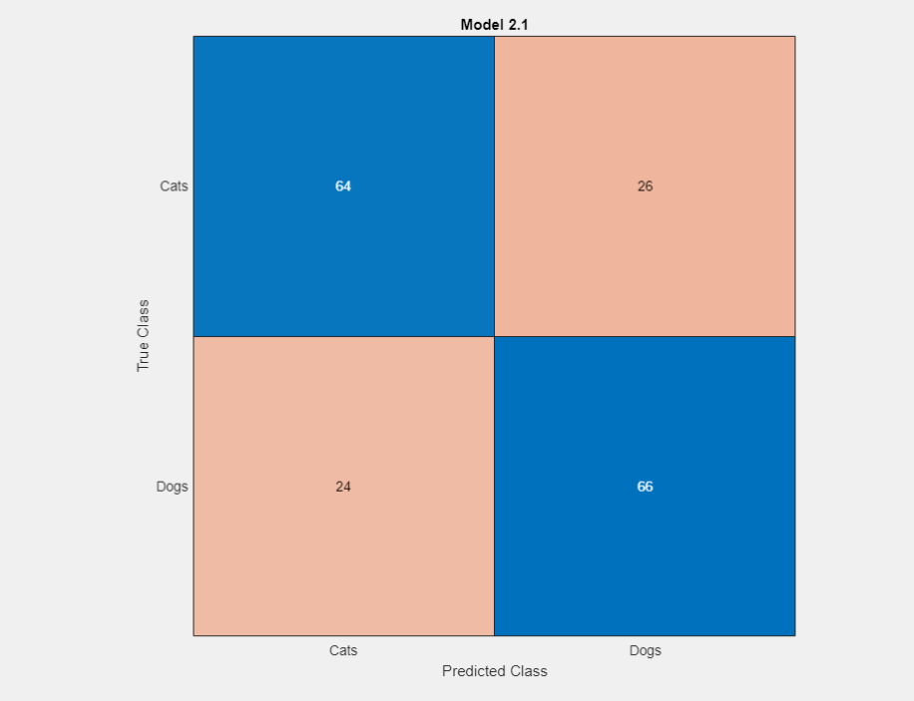
Workflow
3. Train and Test a model
b) Train and Test using Classification Learner App
10- Fold Cross validation, Test data : 10%)
Accuracy : varies between 61 to 89%
Notes:
how much you want to avoid misclassifying each training example

Slide 7
Thank You !

